Slide 1
INTRODUCTION TO DIGITAL SPEECH PROCESSING
(ET60007)
Dr. Shyamal Kumar Das Mandal
Assistant Professor
sdasmandal@cet.iitkgp.ernet.in
Centre for Educational Technology
Indian Institute of Technology, Kharagpur

Slide 2
Introduction and motivation

Slide 3
Course objective
Categories and label the different speech sound for a given speech signal based on spectrographic view
Explain the psychoacoustic properties of speech perception and production
Design the Uniform tube model for speech sound production and implement it based on discrete time modeling
Extract the fundamental frequency of speech signal based on time domain and frequency domain method
Extraction spectral parameters and time domain parameters of speech signal for speech technology application
Design an simple TTS and ASR system.
Explain the prosodic structure of spoken language and design F0 contour modeling based on Fujisaki Model

Slide 4
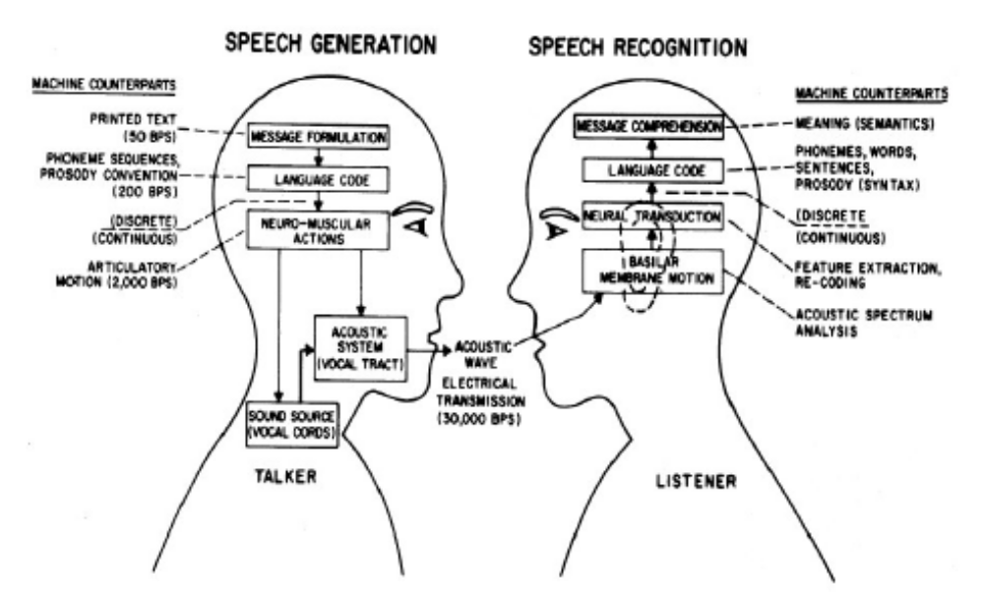
Human speech Production and Perception processes

Slide 5
Information manifestation in the segmental and suprasegmental features of speech
Input Information
Rule of Grammar
Rule of Prosody
Physiological Constraints
Physiological Constraints
Segmental and supra Segmental Features of speech
Linguistics
Lexical, Syntactic, Semantic,
Pragmatic
Massage Planning
Utterance Planning
Motor Command Generation
Speech Sound Production
Para- Linguistics
Intentional,
Attitudinal,
Stylistic
Non- Linguistics
Physical,
Emotional

Slide 6
Algorithms
(Programming)
Psychoacoustics
Room acoustics
Speech production
Speech Processing
Acoustics
Signal
Processing
Information
Theory
Phonetics
Fourier transforms
Discrete time filters
AR(MA) models
Entropy
Communication theory
Rate-distortion theory
Statistical SP
Stochastic
models

Slide 7
Speech Processing Model
Information Source
Human speaker—lots of variability
Measurement / Observation
Acoustic waveform / articulatory
positions/neural control signals
Signal Representation
Signal Processing
Signal Transformation
Extraction of Information
Utilization of Information
Human listeners,
machines

Slide 8
Speech Applications
Speech coding
Speech synthesis
Speech recognition and understanding
Speech enhancement (noise reduction)
Language Identification
Voice conversion
Spoken Language acquisition

Slide 9
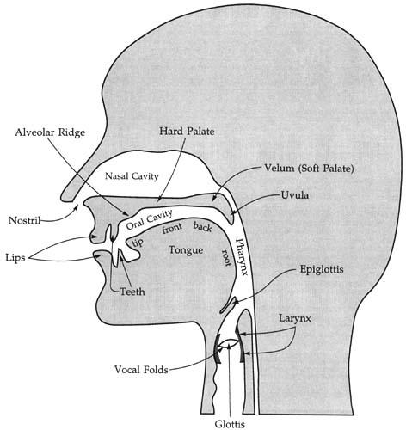
Articulators for Speech
Notes:
CT_2003-11-27_E

